Slide 1
Becoming a CVE Numbering Authority (CNA)
CVE Team
Notes:
Voice Track:
Hello and welcome to Becoming a CVE Numbering Authority (CNA) presentation, presented by the CVE team.

Slide 2
Overview
Defining CNAs
Includes role of the CNA; benefits of being a CNA; qualifications; and cost
CVE Program Organization
How to Organize your CNA(s)
Defining the scope of your coverage
CNA internal processes
CNA resources and community involvement
Notes:
Voice Track:
This presentation includes an overview of what defines a CNA, how the CVE program is organized, how to organize your CNA program, how to define the scope of what you will cover, internal CNA processes, CNA resources, and ways to get involved in the CNA community.

Slide 3
Defining CNAs
| 3 |
Notes:
Voice Track: So, let’s get started……..what defines a CNA.

Slide 4
Role of the CNA
What are CVE Numbering Authorities (CNAs)?
CNAs are organizations that are authorized to assign CVE IDs to vulnerabilities affecting products within their distinct, agreed upon scope
Why do we need CNAs?
CNAs help address the CVE Program's primary challenge to satisfy the demand for timely, accurate CVE ID assignments, while rapidly expanding the scope of coverage to address the increasing number of vulnerabilities and evolving state of vulnerability management
What value do CNAs provide?
CNAs allow CVE IDs to be produced more quickly and in a more distributed manner
Notes:
Voice Track:
CVE Numbering Authorities are authorized to assign CVE IDs to vulnerabilities affecting products within their agreed upon scope. CNAs help to address the CVE Program's primary challenge to satisfy the demand for timely and accurate CVE ID’s, while rapidly expanding the scope of coverage to address the increasing number of vulnerabilities and evolving state of vulnerability management. CNAs allow CVE IDs to be produced more quickly and in a more distributed manner.

Slide 5
Benefits of Being a CNA: Minimize Embargoed Information
| 5 |
Left out of the loop
CNA of Last Resort CNA-LR
Researcher
Vendor
(CNA)
Notes:
Voice Track:
One major benefit of becoming a CNA is that you can minimize the number of people with access to embargoed information.

Slide 6
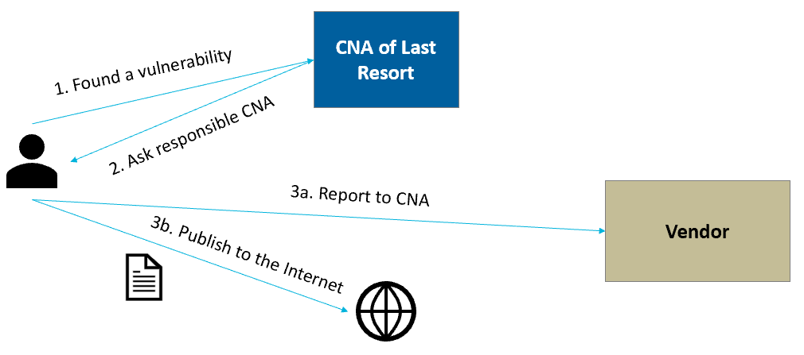
Benefits of Being a CNA: More Efficient Process
| 6 |
Not a CNA?
Researcher go directly to CNA of last resort.
CNA?
Researcher go directly to you, the CNA.
Notes:
Voice Track:
CNAs are able to communicate vulnerabilities quicker to their customer base because the process becomes more efficient. The CNA is able to publicly disclose a vulnerability with an already assigned CVE ID and researchers requesting a CVE ID for vulnerabilities within your scope, go directly to you, the CNA, instead of the CNA of last resort.

Slide 7
Benefits of Being a CNA: Control the Message
| 7 |
CVE entry text (written by CNA-LR)
Advisory text (Not a CNA)
Vulnerability in Product A 3.1.2 and earlier allows attackers to cause a denial of service and possibly execute arbitrary code.
Vulnerability in Product A 3.x before 3.2 and 2.x before 2.5 allows authenticated users to cause a denial of service.
CVE entry text (written by CNA)
Advisory text (CNA)
Vulnerability in Product A 3.x before 3.2 and 2.x before 2.5 allows authenticated users to cause a denial of service.
Vulnerability in Product A 3.x before 3.2 and 2.x before 2.5 allows authenticated users to cause a denial of service.
Notes:
Voice Track:
CNAs get to control the CVE publication release process for vulnerabilities in their products and CNA’s can control the disclosure of vulnerability information without pre-publishing.

Slide 8
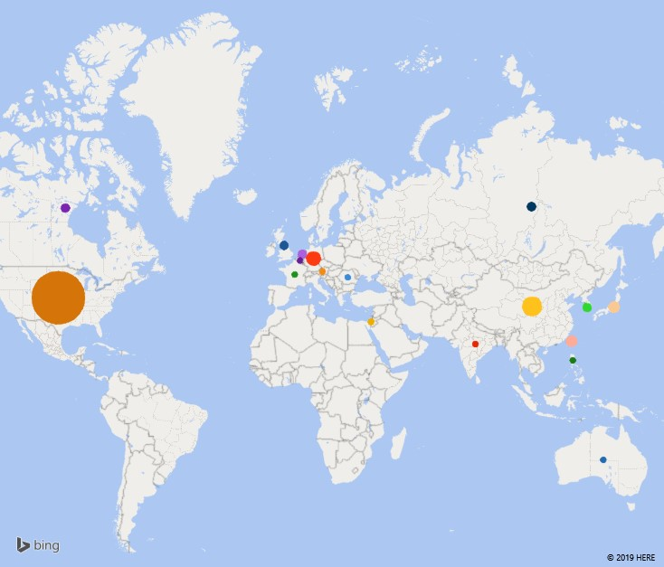
Benefits of Being a CNA: Part of an International Community
| 8 |
Notes:
Voice Track:
As a CNA, you are a part an international community. Participating CNA’s are from all over the world and are made up of all types of CNAs such as Vendors and Projects, Vulnerability Researchers, National and Industry CERTs, Bug Bounty Programs, Root CNAs, and Program Root CNAs.

Slide 9
CNA Qualifications
A CNA must be either a:
Vendor
Coordination center
Bug Bounty
Researcher
A CNA must be an established distribution point or source for first-time product vulnerability announcements (which may concern their own products)
A CNA must be willing to follow CNA Rules
The CNA must follow coordinated disclosure practices as determined by the community they serve in order to reduce the likelihood that duplicate or inaccurate information will be introduced into the CVE List
Notes:
Voice Track:
A CNA must be a vendor with a substantial user base and established security advisory capabilities OR an organization that acts a neutral interface between Researcher and Vendor, must be willing to follow the CNA rules and lastly, must be able to follow coordinated disclosure practices as defined by the community they serve. Following the coordinated disclosure practices helps reduce the likelihood that duplicate or inaccurate information will be introduced into the CVE List.
Root CNA and Primary CNA are defined in Governance section.

Slide 10
Cost of Being a CNA
There is no monetary fee
There is no contract to sign
You are expected to put in the time and effort to implement the CNA Rules
Notes:
Voice Track:
The cost for being a CNA: there is no monetary fee, there is not contract to sign and CNAs are expected to put in the time and effort to implement and follow the CNA Rules.

Slide 11
CVE Program Organization
| 11 |
Notes:
Voice Track: How is the CVE program organized?

Slide 12
CVE Board
CVE Board
MITRE (Program Root CNA, Secretariat, CNA-LR)
DHS CISA (Sponsor Organization)
Sub-CNA
Sub-CNA
Root CNA
Sub-CNA
Sub-CNA
Sub-CNA
Sub-CNA
Sub-CNA
Sub-CNA
Notes:
Voice Track: The CVE Board performs an essential role providing strategic, governance, and operational advisory functions and comprised of Industry, government, and academic stakeholders from around the world.

Slide 13
Program Sponsor
CVE Board
MITRE (Program Root CNA, Secretariat, CNA-LR)
DHS CISA (Sponsor Organization)
Sub-CNA
Sub-CNA
Root CNA
Sub-CNA
Sub-CNA
Sub-CNA
Sub-CNA
Sub-CNA
Sub-CNA
Notes:
Voice Track: The CVE program is sponsored by the Department of Homeland Security (DHS), Cybersecurity and Infrastructure Security Agency [CISA]) and funds the MITRE Corporation to operate the CVE Program as an independent, objective third party.

Slide 14
Program Root CNA, Secretariat, CNA-LR
CVE Board
MITRE (Program Root CNA, Secretariat, CNA-LR)
DHS CISA (Sponsor Organization)
Sub-CNA
Sub-CNA
Root CNA
Sub-CNA
Sub-CNA
Sub-CNA
Sub-CNA
Sub-CNA
Sub-CNA
Notes:
Voice Track: The MITRE Corporation is the Program Root CNA, Secretariat and the CNA-Last Resort (CNA-LR). MITRE is the final arbiter of disputes, manages the CVE Program operations; hosts the CVE Master List; manages the CVE numbering scheme; maintains the public presence; performs assignment of CVE IDs for products not covered by other CNAs and executes a range of improvement activities (e.g., automation, process, operations, rules).

Slide 15
Root CNA
CVE Board
MITRE (Program Root CNA, Secretariat, CNA-LR)
DHS CISA (Sponsor Organization)
Root CNA
Sub-CNA
Sub-CNA
Sub-CNA
Sub-CNA
Sub-CNA
Sub-CNA
Sub-CNA
Sub-CNA
Notes:
Voice Track: A Root CNA roles is to manage entities within a distinct, agreed upon scope; manages operations within a distinct, agreed upon scope; ensures retail assignments within a distinct, agreed upon scope

Slide 16
Sub-CNA
CVE Board
MITRE (Program Root CNA, Secretariat, CNA-LR)
DHS CISA (Sponsor Organization)
Sub-CNA
Sub-CNA
Root CNA
Sub-CNA
Sub-CNA
Sub-CNA
Sub-CNA
Sub-CNA
Sub-CNA
Notes:
Voice Track: A Sub-CNA is authorized to assign CVE IDs to products within a distinct, agreed upon scope

Slide 17
Which Root CNA Is Right for You?
Which parent CNA is right for you?
National level
Industry level
Program Root level
If you are not sure, contact the CVE Program Root CNA:
cveform.mitre.org
Email us at cna-coordinator@mitre.org
Contact information for the CNAs:
cve.mitre.org
Notes:
Voice Track: So, who do you contact in the CNA hierarchy? Your CNA status will determine which parent CNA is right for you. There are National Levels, Industry Levels and Program Root Levels. If you are not sure who to contact, you can reach out to the CVE program Root CNA at cveform.mitre.org or email us at cna-coordinator@mitre.org. All active CNA contact information is located on the CVE webpage, at cve.mitre.org, then go the “CNA” tab and select “Participating CNAs”.

Slide 18
Organizing Your CNA Program
| 18 |
Notes:
Voice Track: How to organize your CNA program.

Slide 19
Organizing Your CNA Program
How you set up your CNA program is influenced by how your organization is configured.
Most organizations designate a single group to manage their CNA program; however, that is not always the case. For example:
The Android and Chrome PSIRTs work independently and act as their own CNAs, even though they are both part of Google
Cisco and Cisco Talos are separate CNAs due to their vastly different scopes (i.e., Cisco products versus the vulnerabilities they found during their research)
Within Dell, the Dell CNA covers Dell, EMC products, and the products of many of their subsidiary companies; however, they do not cover VMware or Pivotal, which have their own CNA program
Notes:
Voice Track: How you set up your CNA program is influenced by how your organization is configured. Most organizations designate a single group to manage their CNA program; however, that is not always the case. For example: The Android and Chrome PSIRTs work independently and act as their own CNAs, even though they are both part of Google. Cisco and Cisco Talos are separate CNAs due to their vastly different scopes. One covers Cisco products and the other finds vulnerabilities in third-party products. Within Dell, the Dell CNA covers Dell, EMC products, and the products of many of their subsidiary companies; however, they do not cover VMware or Pivotal, which have their own CNA program.

Slide 20
Single CNA for the Entire Organization
CNA 1
Service Area 1
Service Area 2
Service Area 3
Notes:
Voice Track: There a many different types of CNA structures. There are single CNAs, where a single group handles all vulnerabilities.

Slide 21
CNA for Each Unit
CNA 1
CNA 2
CNA 3
Service Area 1
Service Area 2
Service Area 3
Notes:
Voice Track: There are multiple groups that handle their own vulnerabilities, where a CNA is created for each independent group.

Slide 22
Hybrid
Pseudo-CNA 1
Coordinating
Organization
Service Area 1
CNA 1
Pseudo-CNA 2
Service Area 2
Pseudo-CNA 3
Service Area 3
Notes:
Voice Track: There are single CNAs that handle coordination with multiple internal groups. For example, the CNA chooses to create unofficial sub-CNAs to which it can give blocks of IDs.

Slide 23
Scope
| 23 |
Notes:
Voice Track: How to define your scope.

Slide 24
Defining Scope
A CNA’s scope defines the vulnerabilities to which it is responsible for assigning CVE IDs
The scope sets expectations, which should:
Prevent CNAs with overlapping scopes (e.g., their Root CNA) from assigning duplicate IDs
Save reporters’ time and frustration by preventing them from reporting irrelevant issues
Save the CNA time by reducing the number of unwanted reports
Save the Root CNA time by reducing the number of complaints by unhappy reporters
Notes:
Voice Track: A CNA’s scope defines the vulnerabilities to which it is responsible for assigning CVE IDs. The scope sets the expectations, which should: help prevent overlapping scopes with other CNAs, will save reporters time and frustration by preventing them from reporting irrelevant issues, save the CNA time by reducing the number of unwanted reports and lastly, save the Root CNA time by reducing the number of complaints by unhappy reporters.

Slide 25
Scope: Types of CNAs
Research Organization
Vendor
Open- Source Project
Coordination Center
Vendor
Notes:
Voice Track: There are different types of CNA’s: Vendor CNAs that cover products (e.g., Microsoft, OpenSSL, Debian), CNA Coordinators that cover the vulnerabilities coordinated by the organization e.g., CERT/CC, JPCERT/CC, HackerOne, CNA Research Organizations that cover the vulnerabilities discovered by individual researchers (e.g., Rapid7), and CNAs that are a combination of different types, referred to Mixed CNAs (e.g., Flexera (vendor and research), Drupal (vendor and coordinator) and lastly, there are other CNAs that do not fall into a typical category as described above (e.g., MITRE).

Slide 26
Scope: Limited by Advisory Policy
Are there some scenarios where advisories are not published?
All advisories must meet the CVE Program’s requirements for being published:
Must have a URL
The Terms of Service must allow a link to the URL
The document linked to the URL must contain the minimum required information for a CVE Entry:
Product
Version
Problem type (vulnerability type or impact)
Must not require a fee to access
Notes:
Voice Track: All advisories must meet the CVE Program’s requirements for being published. Advisories must have a URL, the Terms of Service must allow a link to the URL, the document linked to the URL must contain the minimum required information for a CVE Entry. The minimum required information are: Product, Version, Problem type (vulnerability type or impact) and the URL must not require a fee to access.

Slide 27
Scope: Limited by Products
Do you plan to cover all of the products you produce?
Consider the following types of products when deciding which products will be covered within the scope:
Products from subsidiary companies
Products from newly acquired companies
Discontinued products
Versions that have reached their end of support
Experimental products or development branches
Freebie products
Notes:
Voice Track: Do you plan to cover all products or just some of them? Consider the following types of products when deciding which products will be covered within the scope: such as products from subsidiary companies, products from newly acquired companies, discontinued products, versions that have reached their end of support, experimental products or development branches and freebie products.

Slide 28
Scope: Limited by Vulnerability Type
Explain the criteria used to determine if an issue is a vulnerability
e.g., https://msdn.microsoft.com/en-us/library/cc751383.aspx
Provide an explicit list of the types of issues not considered vulnerabilities to help limit the number of unwanted requests:
Self-DoS
CSRF logout
Insecure default configurations
Default credentials
Notes:
Voice Track: First, determine if an issue is a vulnerability, there are many interpretations. To avoid any confusion, provide an explicit list of the types of issues not considered vulnerabilities to help limit the number of unwanted requests e.g. Self-DoS, CSRF logout, insecure default configurations and default credentials.

Slide 29
CNA Processes
| 29 |
Notes:
Voice Track: CNA processes

Slide 30
Process: Accepting Vulnerability Reports
Are third party requests accepted?
What information should vulnerability reporters provide?
If so, provide contact information:
Contact information should be provided to your Root CNA
A registry of contact information is maintained on the CVE Program website at cve.mitre.org
Notes:
Voice Track: How are you going to accept vulnerability request? What information should vulnerability reporters provide? Will your organization accept third party reports? These are some of the issues a CNA needs to consider when developing their CNA processes. To assist vulnerability reporters, your Root CNA must have your contact information. In addition, the CVE program maintains a registry of contact information for CNAs so reporters can contact you. The registry is located at cve.mitre.org, go the “CNA” tab and select “Participating CNAs”.

Slide 31
Process: Block Management
Who in your organization can assign IDs?
At what point in the process should a CVE ID be assigned?
Remediation and triage
Disclosure
Initial Report
When an ID is assigned, how is it recorded?
How are vulnerabilities tracked (i.e., which vulnerability is assigned to which CVE ID)?
Notes:
Voice Track: Another process that a CNA needs to think through, is how will the CNA manage how CVE ID’s will be processed within the organization. Here are a few questions you should ask, when developing your block management process. For example, Who in your organization can assign IDs? At what point in the process should a CVE ID be assigned? When an ID is assigned, how is it recorded? How are vulnerabilities tracked (i.e., which vulnerability is assigned to which CVE ID)? CNAs who don’t have established policies for these questions run the risk of assigning the same CVE ID to multiple vulnerabilities.

Slide 32
Process: Publish a Disclosure Policy
The disclosure policy should at least include the expected timeframe and conditions under which vulnerability information will be published
The following additional communication points are advised:
Acknowledge receipt of submission (i.e., provide an initial response to reporter, even if it is just a “we received your request and are looking into it”)
Give reporter approximate time it will take to get back to them with a determination on whether there is a vulnerability
Advise the reporter when they can expect to receive the CVE ID for the vulnerability
Advise the reporter when the issue will be fixed and when an advisory can be published
Notes:
Voice Track: Before the CNA can be accepted into the CNA program, a disclosure policy must be published. The disclosure policy should at least include the expected timeframe and conditions under which vulnerability information will be published. We strongly suggest that the following communication points be included: 1) Acknowledge receipt of submission (i.e., provide an initial response to reporter, even if it is just a “we received your request and are looking into it”)
2) Give reporter approximate time it will take to get back to them with a determination on whether there is a vulnerability, 3) Advise the reporter when they can expect to receive the CVE ID for the vulnerability, and 4) Advise the reporter when the issue will be fixed and when an advisory can be published.

Slide 33
Process: Publication of Advisories
Advisories must be made public
The advisory should clearly state which CVE ID is associated with which vulnerability
CVE Entries should be sent within 24 hours of the vulnerability being made public
Are CVE Entries sent to the Root CNA, or directly to the Program Root CNA?
The Root CNA may require CVE Entries be sent directly to them
Notes:
Voice Track: When publishing vulnerability advisories, advisories must be made public. Making advisories public is a requirement of the CVE program. In addition, the advisory should clearly state which CVE ID is associated with which vulnerability. Moreover, CVE Entries should be sent within 24 hours of publication. You should also consider, if the CVE Entry be sent to the Root CNA or directly to the Program Root CNA. Your Root CNA may require CVE Entries be sent directly to them.

Slide 34
Process: CVE Entry Update Requests
CNAs will receive requests to update CVE Entries that have been created; a process should be established to handle these requests
If the request to update a CVE Entry is sent to a Root CNA or the Program Root CNA, the issuing CNA should decide if they want to be notified.
Decide if notification is necessary under the following conditions:
Spelling or grammar issues
Adding a reference
Notes:
Voice Track: Often, CNAs will receive requests to update CVE Entries that have already been created hence a process should be established to handle these types of requests. If the request to update a CVE Entry is sent to a Root CNA or the Program Root CNA, the issuing CNA should decide if they want to be notified of any updates. Consider the types of updates that will require notification, updates may be insignificant, like spelling or grammar issues, other updates will have more significance, like adding a reference to the CVE Entry.

Slide 35
Information CNAs Are Required to Provide to their Parent CNA
Point of Contact (POC)
As defined by the parent CNA
Scope definition
Disclosure policy
Root CNAs may require additional information to be provided
Notes:
Voice Track: CNA’s are required to provide the following information to their parent CNA, before participating in the CNA program: 1) Point of Contact (POC) as defined by the parent CNA, 2) Scope definition, 3) Disclosure policy and 4) Root CNAs may require additional information.

Slide 36
CNA Resources and Community Involvement
| 36 |
Notes:
Voice Track: Next, CNA resources and ways to get involved in the CNA community.

Slide 37
Training
Parent CNA provides initial training
Additional Training
CNA Summits
Supplementary documentation, available at https://cveproject.github.io/docs/cna/processes_documentation/index.html
An internal training process should be developed for those who join the team
Program Root CNA (currently MITRE) can help provide supplemental material
Notes:
Voice Track: Parent CNAs are responsible for training sub-CNAs and the training should include a CNA rules overview and how to obtain block IDs from your Parent CNA. Additional knowledge sharing opportunities can be obtained at the CNA summits and supplemental documents also located on (https://cveproject.github.io/docs/cna/processes_documentation/index.html). Parent CNA’s should also develop an internal training process for new team members. The Program Root CNA can help with providing supplemental material to assist you.

Slide 38
CVE Working Groups (1 of 3)
Automation Working Group (AWG)
Focused on identifying and advancing proposals for the collaborative design, development, and deployment of automated capabilities that support the efficient management of the CVE Program.
Documents CVE ID Allocation Service Specification AWG Charter | Repositories & Projects CVE ID Allocation Service CVE List GitHub Automation Pilot CVE JSON Schema Project CNA Registry Project AWG GitHub Repository
Notes:
Voice Track: The CVE Program has a number of Working Groups (WGs) actively focused on improving processes, workflows, and other aspects of the program as CVE continues to grow and expand. As a participating CNA, you can join the working groups to help improve the program. Currently, there are a five working groups and multiple projects underway. The Automation Working Group (AWG) is focused on identifying and advancing proposals for the collaborative design, development, and deployment of automated capabilities that support the efficient management of the CVE Program.

Slide 39
CVE Working Groups (2 of 3)
Strategic Planning Working Group (SPWG)
Focused on the long-term strategy (1-5 years) and goals of the CVE Program; will work closely with the CVE Board to determine goals and objectives and will act to achieve them.
CNA Coordination Working Group (CNACWG)
Focused on providing a forum for more effective communication and participation by the CVE Numbering Authorities (CNAs).
CVE Entry Quality Working Group (QWG)
Focused on identifying areas where CVE content, rules, guidelines, and best practices must improve to better support stakeholder use cases.
Documents
TBA
Repositories & Projects
SPWG GitHub Repository
Documents
CNACWG Charter
Repositories & Projects
TBA
Notes:
Voice Track: The Strategic Planning Working Group (SPWG) is focused on the long-term strategy (1-5 years) and goals of the CVE Program; will work closely with the CVE Board to determine goals and objectives and will act to achieve them. The CNA Coordination Working group (CNACWG) is focused on providing a forum for more effective communication and participation by the CVE Numbering Authorities (CNAs). The CVE Entry Quality WG (QWG) is focused on identifying areas where CVE content, rules, guidelines, and best practices must improve to better support stakeholder use cases.

Slide 40
CVE Working Groups (3 of 3)
Outreach and Communications Working Group (OCWG)
Focused on promoting the CVE Program to achieve program adoption and coverage goals through increased community awareness.
Notes:
Voice Track: The Outreach and Communications Working Group is focused on promoting the CVE Program to achieve program adoption and coverage goals through increased community awareness.

Slide 41
Other Community Participation
CNA mailing list
For program wide announcements
Used by CNAs to discuss important topics
Limited to CNA and Board members
CNA Summits
Yearly conference to discuss lessons learned, issues, and program improvements
Webinars
Ad-Hoc meetings to discuss issues affecting CNAs and the CVE Program
CVE CNA SharePoint Site
Notes:
Voice Track: There are many ways to participate in the CNA community such as subscribing to the CNA mailing list to receive program wide announcements and to discuss important topics with the CNA community and CVE Board members (most are also CNA’s themselves). Participating in the CNA summits, webinars and handshake are other ways to participate in the CNA community.

Slide 42
Questions?
If you have questions or would like to request a meeting with the CNA Coordination team to learn more about the CNA program:
Submit a request via cveform.mitre.org or
Send an email request to cna-coordinator@mitre.org
Notes:
Voice Track: Do you have any questions? Would like to set up a meeting with the CNA Coordination team? To request a meeting to learn more about the program by going to cveform.mitre.org or send an email request to cna-coordinator@mitre.org.

Slide 43
Conclusion
| 43 |
Notes:
Voice Track: This concluded this presentation.

