Slide 1
Assigning CVE IDs
CVE Team
Notes:
Greetings and welcome to the CVE program’s video on assigning CVE IDs. CVE Numbering Authority (CNA) Rules define the requirements for assigning CVE IDs. The requirements are split into three counting decisions (defining how many vulnerabilities have been reported) and five inclusion decision (which define if a CVE ID should be assigned and who should do the assignment). We will go over each of the decisions in turn.

Slide 2
CNT1 – Divide into independently fixable bugs
Notes:
CNT1 – Divide into independently fixable bugs

Slide 3
Establish the Baseline
Bug
CNT1
CNT2
CNT3
INC1
INC2
INC3
INC4
INC5
Vulnerability Report
Bug
Bug
Bug
Bug
Notes:
The first rule (CNT1) states that the reported vulnerabilities should be split by independently fixable bugs. The CVE Program’s method of counting vulnerabilities is likely different than that of the reporter, so the counting rules start by breaking the vulnerabilities down into their base components. This is meant to help ensure that each vulnerability only receives one CVE ID and there are no overlapping assignments.

Slide 4
Merge Dependent Bugs
Bug
CNT1
CNT2
CNT3
INC1
INC2
INC3
INC4
INC5
Vulnerability Report
Bug
Bug
Dependency
Bug
Bug
Notes:
If multiple bugs must be fixed to mitigate the vulnerability, or if by fixing one bug, the rest of the bugs no longer result in a vulnerability, then those bugs are not considered “independently fixable” and should be grouped together. If you are unsure whether the bugs are independently fixable, then the bugs should be grouped together. If you later discover that the bugs are independently fixable, then you follow the CVE ID split process defined in the CNA rules and covered in a separate video.
“Independently fixable” is the primary method the CVE program uses to distinguish two vulnerabilities from each other, and thus ensure each vulnerability receives only one CVE ID assignment.

Slide 5
Difficulties in Identifying Independent Bugs
Notes:
Identifying the bugs and determining whether they are independently fixable is probably the most difficult part of assigning CVE IDs.

Slide 6
What is a Bug?
CNT1
CNT2
CNT3
INC1
INC2
INC3
INC4
INC5
✓
Notes:
For example, not everyone agrees on what a bug is, and the rule itself does not provide a definition; instead, it is left up to the CNA’s discretion. However, CNT2.2 (covered later in the video) provides some guidance on how to think about what should be considered a bug.

Slide 7
Quality of the Information Changes the Result
Externally Observable
Problem in the Code
CNT1
CNT2
CNT3
INC1
INC2
INC3
INC4
INC5
XSS via the A parameter
XSS via the B parameter
Error in XSS filters
XSS via the C parameter
Notes:
Also, the rule assumes detailed knowledge of the underlying code. Without this knowledge, it is often difficult to tell whether the bugs are truely independently fixable, hence the need for “unsure” option in the rule.

Slide 8
Could, Not Should
Scenario 1:
CNT1
CNT2
CNT3
INC1
INC2
INC3
INC4
INC5
if (strcmp(cmd, "show") == 0) {
strcpy(str, long_input);
process_show_command(str); }
elsif (strcmp(cmd, "clear") == 0) {
strcpy(str, long_input);
process_clear_command(str); }
Notes:
According to the rules, CNAs should split based on whether the bugs COULD be fixed independently, not whether they were or even whether it would be wise to do so. Take the following code segment for example. Each call to strcpy (highlighted in red) results in a buffer overflow. To fix the bugs, the length of the input needs be checked before the strcpy call.

Slide 9
Options for Fixes Should Not Impact Assignments
Fixed Together
Fixed Independently
if (len (long_input) < MAX_LEN) {
if (strcmp(cmd, "show") == 0) {
strcpy(str, long_input);
process_show_command(str); }
elsif (strcmp(cmd, "clear") == 0) {
strcpy(str, long_input);
process_clear_command(str); }}
if (strcmp(cmd, "show") == 0) {
if (len (long_input) < MAX_LEN) {
strcpy(str, long_input); }
process_show_command(str); }
elsif (strcmp(cmd, "clear") == 0) {
if (len (long_input) < MAX_LEN) {
strcpy(str, long_input); }
process_clear_command(str); }
Notes:
A length check could be placed just before the call, thus fixing them independently. However, all of the bugs in each of the segments could be fixed by placing the length check at the very beginning of the code segment, assuming that the maximum length for each is the same. Even if this is the way the vendor chooses to fix the vulnerabilities, CNT1 still requires a CVE ID be assigned to each strcpy call because they could have been fixed independently.
Assigning CVE IDs this ways helps avoid a number of issues. For example if some malware were exploiting one of these bugs, the CVE ID should allow the users to specify which bug is being exploited. The whole point of assigning a CVE ID is to easily make these types of distinctions.

Slide 10
Dependent Bugs
Notes:
However, the rule does recognize that not all bugs can be fixed independently.

Slide 11
When are Bugs Not Independently Fixable?
Chains – multiple bugs strung together are required to result in a vulnerability (e.g., an integer overflow that leads to a buffer overflow)
Composites – multiple bugs combine to result in a single vulnerability (e.g., symbolic link attacks require insecure permissions, predictable file names, and a race condition)
In both cases, if one bug is fixed, the other bugs do not result in a vulnerability by themselves
CNT1
CNT2
CNT3
INC1
INC2
INC3
INC4
INC5
Notes:
Chained bugs, including integer overflows that lead to buffer overflows, and composite vulnerabilities, such as symlink attacks, which require a race condition, predictable file names, and weak permissions to be present. In such cases, the bugs are grouped together as a single bug.

Slide 12
Chains: Not Independently Fixable
X
A
B
C
D
CNT1
CNT2
CNT3
INC1
INC2
INC3
INC4
INC5
Use of Signed Integers for Always-Positive Operations
Insufficient Memory Allocation
Incorrect
Range
Check
Integer
Overflow
Heap
Overflow
height = -65534; width = -65534
A
if (height > 64000 ||
width > 64000) {
error("too big!");
}
size = height * width;
buf = malloc(size);
memmove(buf, InputBuf, SZ);
Assumption: The range check will prevent an overflow from occurring.
B
C
D
Notes:
Take the following code segment as an example. It contains a group of chained bugs. There is an incomplete range check that is not accounting for large negative numbers: An integer overflow then occurs when multiplying height and width, which results in too little memory being allocated with the malloc, resulting in a buffer overflow with the memmove.

Slide 13
Chains: Possible Fixes
X
A
B
C
D
CNT1
CNT2
CNT3
INC1
INC2
INC3
INC4
INC5
Use of Signed Integers for Always-Positive Operations
Incorrect
Range
Check
Integer
Overflow
Insufficient Memory Allocation
Heap
Overflow
Fix 1: Correct A (Incorrect Range Check)
Fixes the integer overflow, which prevents the insufficient memory allocation and heap overflow
A fix for the integer overflow will always fix the heap overflow
Fix 2: Check for integer overflow before allocating memory
Fixes C (Insufficient Memory Allocation), which prevents the heap overflow
With C and D fixed, A and B no longer have a security impact, and therefore are no longer vulnerabilities
A fix for the heap overflow will always fix the integer overflow vulnerability
The integer overflow and heap overflow are not independently fixable
Notes:
Implement a fix at any point in the chain of bugs and the vulnerability is neutralized. Correct the range check and the rest doesn’t happen; check for an integer overflow after the multiplication and the rest doesn’t happen; and so on. Thus, they are not independently fixable.

Slide 14
CNT2 – Is there a vulnerability?
Notes:
CNT2 is the second assignment rule. It asks the question “Do the bugs (identified using CNT1) result in a vulnerability?”

Slide 15
What is a Vulnerability?
NIST: A weakness in the computational logic found in products or devices that could be exploited by a threat source. [NISTIR 8138]
ISACA: A weakness in the design, implementation, operation or internal control of a process that could expose the system to adverse threats from threat events [1]
CERT: A software defect that allows an attacker to violate an explicit (or implicit) security policy to achieve some impact (or consequence). [2]
OWASP: A vulnerability is a hole or a weakness in the application, which can be a design flaw or an implementation bug, that allows an attacker to cause harm to the stakeholders of an application. Stakeholders include the application owner, application users, and other entities that rely on the application. [3]
Microsoft: A security vulnerability is a weakness in a product that could allow an attacker to compromise the integrity, availability, or confidentiality of that product. [4]
HackerOne: A software bug that would allow an attacker to perform an action in violation of an expressed security policy. A bug that enables escalated access or privilege is a vulnerability. Design flaws and failures to adhere to security best practices may qualify as vulnerabilities. Weaknesses exploited by viruses, malicious code, and social engineering are not considered vulnerabilities unless the Security Team says otherwise in the program's policy. [5]
CNT1
CNT2
CNT3
INC1
INC2
INC3
INC4
INC5
Notes:
Before you can answer the question, you must first understand what a vulnerability is. Unfortunately, opinions vary on what should and should not be considered a vulnerability. Some may want to focus on a specific flaw in code, while others may consider not putting a lock on the server room a vulnerability.
[1] https://www.isaca.org/Pages/Glossary.aspx?tid=1975&char=V
[2] http://www.cert.org/vulnerability-analysis/vulnerability-reporting-instructions.cfm?
[3] https://www.owasp.org/index.php/Category:Vulnerability
[4] https://msdn.microsoft.com/en-us/library/cc751383.aspx
[5] https://www.hackerone.com/disclosure-guidelines

Slide 16
The CVE Program’s Definition of a Vulnerability
In general, a vulnerability is defined as a weakness in the computational logic (e.g., code) found in software and hardware components that, when exploited, results in a negative impact to confidentiality, integrity, OR availability. Mitigation of the vulnerabilities in this context typically involves coding changes but could also include specification changes, or even specification deprecations (e.g., removal of affected protocols or functionality in their entirety).
Notes:
The CVE Program also has a definition of what a vulnerability is; however, this definition is NOT USED for assigning CVE IDs. [click for animation]

Slide 17
CNT2 Determines Who Gets to Claim a Vulnerability
CNT2.1 – Product Owner
CNT2.2A – Reporter
CNT2.2B – CNA
CNT1
CNT2
CNT3
INC1
INC2
INC3
INC4
INC5
Notes:
Instead, CNT2 is broken down into sub-decisions that determine who gets to say whether a bug is a vulnerability, which gives the program the flexibility to adapt to different definitions used in different industries, legal regimes, and cultures.

Slide 18
CNT2.1 Product Owner Acknowledgement
Notes:
CNT2.1 says that if the product owner acknowledges the vulnerability, then it is a vulnerability.

Slide 19
CNT2.1 Who is the Product Owner?
Product owners can be:
Anyone who develops, own, or uses software in their products
Software vendors
Hardware vendors
Open source projects
Service providers
CNT1
CNT2
CNT3
INC1
INC2
INC3
INC4
INC5
Notes:
Anyone who offers software for use by someone else is considered a product owner. Product owners include software vendors, hardware vendors, open source projects, and service providers.

Slide 20
Upstream vendors cannot override downstream vendor claims
Notes:
Modern software is an amalgamation of third-party code sprinkled in with some new code and it is often the case that vulnerabilities are inherited from the third-party code. CNT3 goes into this relationship in more detail, but for CNT2, if any product owner in the chain of software claims there is a vulnerability, then for CVE, there is a vulnerability, even if that vulnerability was inherited somewhere upstream and upstream disagrees. If the product owner believes there is a vulnerability, then they should get a CVE ID to identify it and use for coordination.

Slide 21
CNT2.1 What is an Acknowledgement?
Vendor needs to clearly state
There is a vulnerability
Provide enough information to ensure it is acknowledging the same vulnerability
CNT1
CNT2
CNT3
INC1
INC2
INC3
INC4
INC5
Notes:
OK, so what is needed to satisfy CNT2.1? First, there needs to be a clear statement by the owner that a vulnerability affects their product and enough information in the acknowledgement to be certain it is acknowledging the vulnerability in question.

Slide 22
What do you do if…
The software owner does not acknowledge the vulnerability
The software owner denies the vulnerability
You cannot contact the software owner
You are not sure who owns the software
Use CNT2.2
CNT1
CNT2
CNT3
INC1
INC2
INC3
INC4
INC5
Notes:
So what do you do if …
The software owner does not acknowledge the vulnerability
The software owner says it is not a vulnerability
You can’t contact software owner
You aren’t sure who the software owner is
Or there is some other reason why you aren’t certain whether the vendor acknowledged the vulnerability?
In these cases, you should use CNT2.2

Slide 23
CNT2.2 Options
CNT2.2A – Claim-based model
Reporter claims there is a vulnerability
Reporter says there the vulnerability has a negative impact
CNT2.2B – Policy-based model
CNA determines there has been a security policy violation
CNT1
CNT2
CNT3
INC1
INC2
INC3
INC4
INC5
Notes:
CNAs must follow CNT2.1. However, for CNT2.2 they are given the option of 2.2A or 2.2B.
CNT2.2A says reporter of the vulnerability gets to decide so long as they explain the negative impact of the vulnerability. CNT2.2A is also known as the claim-based model since the decision is based on the claims of the reporter
CNT2.2B (also known as the policy-based model) says that the CNA must determine that there is a security policy violation.

Slide 24
CNT2.2 Comparison
CNT2.2A Claim-based Model
CNT2.2B Policy-based Model
CNT1
CNT2
CNT3
INC1
INC2
INC3
INC4
INC5
Pros
Easy
Fast
Cons
Inherently trusts reporters
Could result in wide variations in abstraction
Requires distinct claims
Opinions differ on identification of negative impact
Pros
Higher accuracy
Tends to be incontrovertible
More consistent assignments
Cons
Users and vendors do not always agree on security policy
Many of the policies are not often documented
Hard to know from the outside
Notes:
CNT2.2A was created for speed. It was made for CNAs that process large volumes of vulnerability reports with varying levels of detail and affect a wide variety of products so that they can assign CVE IDs in a timely manner.
CNT2.2B, on the other hand, is for CNAs that can take their time to get the facts straight and make a high-quality assignments.
There are drawbacks to each option to consider:
CNT2.2A not only trusts the reporter to thoroughly research the vulnerability, it also trusts them to clearly delineate between their claims and (to a certain extent) be familiar with CVE’s assignment rules.
CNT2.2B assumes that the security policy is documented, the CNA knows what the policy is, and that everyone agrees with how to interpret the policy.
In addition, both rely on subjective decisions by the CNA (which have the potential to lead to contrary opinions):
For A, the CNA must determine what constitutes a negative impact;
For B, the CNA must interpret the security policy.

Slide 25
CNT2.2 Example
Stored XSS vulnerability in the admin page of a WordPress module allows unauthenticated attackers to obtain cookies
CNT1
CNT2
CNT3
INC1
INC2
INC3
INC4
INC5
CNT2.2A Claim-based Model
CNT2.2B Policy-based Model
The reporter claims there is an XSS vulnerability (improper/no sanitation)
The reporter says it can be used to obtain cookies
Assign a single CVE ID
Regular users should not have access to admin pages except wp-admin/admin-ajax.php
Can administrators inject arbitrary script into pages?
Only if they have the unfiltered_html permission, which they have by default except when WordPress is installed in Multisite mode
Assign one or two CVE IDs, depending on the answers to the questions
Notes:
Let's take a look at an example to show the differences between the two. We have a common vulnerability report. There is a stored cross-site scripting vulnerability in an admin page of some WordPress module that allows unauthenticated attackers to obtain cookies.
For CNT2.2A, the reporter says there is a cross-site scripting vulnerability and it has a negative impact of obtaining cookies. There is a clear claim and negative impact, so it get an ID. Simple.
For CNT2.2B, things are little more complex. There are two potential security policy violations in this claim. The first is that unauthenticated users should not be able to access admin pages, except for wp-admin/admin-ajax.php. All AJAX calls go through admin-ajax.php, despite its name. So if the attacker is accessing any admin page other than admin-ajax.php, then there is a policy violation and a CVE ID should be assigned.
The next place there might be a violation is the arbitrary execution of scripts to obtain cookies, the cross-site scripting attack. In many cases, this violation would be dependent on the access violation and therefore, would not warrant a second CVE ID. But not always. So let’s look at the cases where there isn’t a violation in accessing the page. In the admin-ajax.php case, it is straightforward. Normal users are generally not allowed to inject arbitrary script into the website, so there is a violation. What about the case where the attacker is an administrator? Administrators are normally allowed to put script in their website, right? Correct, WordPress gives administrators the unfiltered_html permission by default… except when WordPress is installed in Multisite mode. So if the module can be used with WordPress in multisite mode, then there is a policy violation that requires a second CVE ID be assigned.
As I am sure you can see by now, CNT2.2B can get complicated very quickly, whereas CNT2.2A can skip over important details.

Slide 26
CNT3 – Affected Products
Notes:
By the time you reach CNT3, you should have determined how many independently fixable bug there are and whether those bugs result in vulnerabilities. CNT3 is used to determine which products are affected by the vulnerability. “Product” being a broad term in the CVE context that includes software (closed and open source), hardware, cloud and software as a service offerings, protocols, standards, etc.

Slide 27
Everyone shares code
Shared libraries
Different versions of the same product
Forks of open source projects
Embedded operating systems
…
Does that mean they share vulnerabilities?
CNT1
CNT2
CNT3
INC1
INC2
INC3
INC4
INC5
Notes:
Everyone shares code. It is a fact of modern software development. So if products are sharing code, does that mean they share the same vulnerability?

Slide 28
Does that mean they share vulnerabilities?
Pros
Product to vulnerability mapping immediately clear
Duplicate assignment requests easier to identify
Cons
More IDs required
False sense of security if missing an assignment
Pros
Ensures an ID for all affected products
Matches how vulnerabilities are normally discussed
Cons
More care needed to ensure duplicate IDs aren’t assigned
CNT1
CNT2
CNT3
INC1
INC2
INC3
INC4
INC5
Notes:
The CVE program treats vulnerabilities in shared code as a single shared vulnerability. The program wants an ID assigned to all vulnerabilities. A per product assignment policy makes that difficult because you must know all the products that share the code to complete the assignments. A complete product-to-vulnerability mapping would be ideal but considered beyond CVE’s scope of identifying vulnerabilities.

Slide 29
Two types of sharing
Direct copy
Different versions of the product
Shared libraries
Open source forks
Copy-and-pasted code
Using external product
Shared third-party libraries
Protocols
Standards
APIs
CNT1
CNT2
CNT3
INC1
INC2
INC3
INC4
INC5
Notes:
There are two types of sharing that the rules recognize. There is direct copying which is when a product shares the same code as another product and then there are products that use other external products, like libraries and standards. Different rules apply in each situation.

Slide 30
Direct Copy
Notes:
For products sharing code directly, the rules are as follows.

Slide 31
One Product Affected, One Vulnerability
Notes:
Obviously, if only one product is affected, there can only be one vulnerability.

Slide 32
Multiple Product
Vulnerability affects all browsers
Chromium
Internet Explorer
Split per Product
Assign CVE IDs at this level
Firefox
CNT1
CNT2
CNT3
INC1
INC2
INC3
INC4
INC5
Notes:
However, if there are multiple products involved, CVE considers these to be separate vulnerabilities.

Slide 33
Shared Codebase
Vulnerability affects all browsers
Chromium
Chrome
Opera
Internet Explorer
Split per Product unless the code is shared
Assign CVE IDs at this level
Shared Code; Merge into One
Firefox
Yandex
Qihoo 360 Secure Browser
CNT1
CNT2
CNT3
INC1
INC2
INC3
INC4
INC5
Notes:
Unless, the products are vulnerable because they share code. In these cases, CVE merges them into a single vulnerability.

Slide 34
If unsure, split one vulnerability per product
Notes:
And finally, if you are not sure whether the products share code, split the vulnerabilities on a per product basis.

Slide 35
Using External Products
If the implementer choose to use an insecure option over a secure one; assign a CVE ID to each affected codebase/product
If the implementer was not given a secure option; assign a CVE ID to the external product
Not sure; assign a CVE ID to each affected codebase/product
CNT1
CNT2
CNT3
INC1
INC2
INC3
INC4
INC5
Notes:
The use of external products, such as libraries, protocols, standards, and APIs, is handled a little differently. The question in these cases is whether the vulnerability should be considered in the external product or one vulnerability per product using the external product.
The deciding factor is whether there is an option to use the functionality in a safe manner and some implementation won’t be affected or if all implementations will be affected. Only if there is no safe option (and thus every product using the vulnerable functionality of the external product is affected) should a CVE ID be assigned at the external product level. If there is an option to use the functionality safely then there is a vulnerability for each product that chose the unsafe option. We don’t want to claim everyone is affected if they aren’t.

Slide 36
Example
Options
Choices
CNT1
CNT2
CNT3
INC1
INC2
INC3
INC4
INC5
SHA-512 - Optional
Product A
SHA-256- Optional
Authentication Protocol 1.1
SHA-1 - Required
Product B
MD5 - Optional
Notes:
For example, let’s say there is an authentication protocol that offers implementers several choices for hashing algorithms, but they are required to support SHA-1. One product support SHA-1 (the required algorithm) and SHA-512 and another product chooses to support the SHA-256, SHA-1, and MD5 algorithms.
Now, someone discovers that they can impersonate a user if the authentication protocol is using a hashing algorithm that is not collision resistant,

Slide 37
Unsafe Choice
Options
Choices
CNT1
CNT2
CNT3
INC1
INC2
INC3
INC4
INC5
SHA-512 - Optional
Product A
SHA-256- Optional
Authentication Protocol 1.1
SHA-1 - Required
Product B
MD5 - Optional
Notes:
MD5 is not collision resistant and so any product that chose to support MD5 is vulnerable to the attack. Since support for the MD5 algorithm is optional, CVE would not consider the authentication protocol vulnerable. Instead, each product that chose to support MD5 would be consider vulnerable. So, in the scenario, the first product would NOT be vulnerable but the second would.

Slide 38
Required to be vulnerable
Options
Choices
CNT1
CNT2
CNT3
INC1
INC2
INC3
INC4
INC5
SHA-512 - Optional
Product A
SHA-256- Optional
Authentication Protocol 1.1
SHA-1 - Required
Product B
MD5 - Optional
Notes:
On the other hand, SHA-1 has also been shown not to be collision resistant and the authentication protocol requires that it be supported by all implementers. Therefore, CVE considers there to be a single vulnerability in the authentication protocol, which is inherited by its downstream implementers.

Slide 39
INC1: In Scope of Authority

Slide 40
CNA Scopes
Root CNA / CNA of Last Resort
CNT1
CNT2
CNT3
INC1
INC2
INC3
INC4
INC5
Open- Source Project
Research Organization
Vendor
Coordination Center
Vendor
Notes:
Every CNA has a scope within which it can assign CVE IDs. Vendors and open-source projects usually have crisp, well-defined scopes that cover only the software they develop. Other types of CNAs like coordination centers, bug bounties, and research organization have less well-defined scopes, usually vulnerabilities for which they coordinate disclosures (in the case of coordination centers and bug bounties) and vulnerabilities they discover (in the case of research organizations). Finally, Root CNAs and CNAs of Last Resort fill in the gaps that the other CNAs don’t cover.
And in an ideal world, these scope would never overlap. However, in practice, overlaps do occur.

Slide 41
Scope Hierarchy
CNT1
CNT2
CNT3
INC1
INC2
INC3
INC4
INC5
First
Priority
Vendors
Open-Source Projects
Coordination Centers
Bug Bounties
Research Organizations
Second
Priority
Third –
Nth
Priority
Root CNAs / CNAs of Last Resort
Notes:
Vendors and open-source projects have the most focused scopes so they get priority in assignment over the other CNAs. Other CNAs must go to the vendor or open-source project CNA to get a CVE ID for vulnerabilities within their scope. Coordination centers, bug bounties, and research organizations are all considered to be at the same level. They defer to vendor and open-source project CNAs but take priority over Root CNAs. Root CNAs defer to the other types of CNAs.

Slide 42
Overlapping Scopes: Vendors and Open Source
Notes:
While for the most part the scopes for vendor and open-source project CNAs tend to be narrowly focus on distinct sets of software, the realities of modern software development mean that sometimes they will overlap.

Slide 43
Software Dependencies
Upstream is a CNA
Upstream gets priority
Escalate to Root if upstream disputes
Upstream is not a CNA
Must make good-faith effort to contact upstream
Option 1
Request CVE ID from CNA of Last Resort
Option 2
Assign if no other CNAs involved
Negotiate assignment if multiple CNAs are involved
Go to CNA of Last Resort if negotiations fail
CNT1
CNT2
CNT3
INC1
INC2
INC3
INC4
INC5
Notes:
The most common cause for overlap is dependency on another vendor or project. In this case, if the vendor or project you are dependent on is a CNA (referred to as upstream), then they gets priority. If they don’t consider the issue a vulnerability, then it should be escalated to their Root CNA. According to CNT2, if a vendor’s product is affected and it acknowledges the vulnerability, then the CVE program will recognize the issue as a vulnerability. This is true regardless of what the upstream CNA says, a CVE ID should be assigned.
If the upstream vendor is not a CNA, then there are more options. First, you must make a good-faith effort to contact upstream. This is a good practice in general, but also helps prevent duplicate assignments if another CNA found the vulnerability and is already working with upstream. From this point, you have a few options. If there aren’t’ other CNAs involved, you can assign a CVE ID yourself, in which case you would be responsible for populating and maintaining the CVE entry, or you could have a CNA of Last Resort assign the ID, which relieves you of the responsibility of populating the entry but also gives up control of the messaging for it. If there are other CNAs involved, then the CNAs negotiate among themselves on who should do the assignment. If no agreement can be reached, then the CNA of Last Resort should do the assignment.

Slide 44
Vendor CNAs Collaborate on a Project
Option 1
Negotiate
Escalate to Root if negotiations fail
Option 2
Create project-focused CNA
CNT1
CNT2
CNT3
INC1
INC2
INC3
INC4
INC5
Notes:
Sometimes vendors come together to collaborate on a project. If more then one of them are CNAs, then there is a scope overlap. In such cases, the CNAs should negotiate among themselves to determine who should assign the CVE ID. If negotiations fail, then the issue should be escalated to a parent CNA.
If the project is large enough, then it may be worth creating a separate CNA scoped solely for the project.

Slide 45
Forks
Defer to main branch (if one exists)
Negotiate the assignment otherwise
Escalate to Root if negotiations fail
CNT1
CNT2
CNT3
INC1
INC2
INC3
INC4
INC5
Notes:
If two or more CNAs maintain their own version of the same product, then they will need to work together to assign CVE IDs. CNT3’s shared codebase policy dictates that they are going to share CVE IDs for their versions so they are going to have to develop some way of deciding who should assign. In general, if there is a version that is considered the “main” branch, then that maintainer should do the assignment. Otherwise, it is going to have to be a negotiation between the CNAs with the option to escalate if there are problems.

Slide 46
Overlapping Scopes: Non-Vendor CNAs
Notes:
What about the overlapping scopes of coordinators, bug bounties, researchers, and Root CNAs?

Slide 47
Coordinators, Bounties, and Researchers
Difficult to detect duplicate assignments before disclosure
Good-faith effort to contact vendor required
Vendor can detect independent discoveries
First to populate gets priority
CNT1
CNT2
CNT3
INC1
INC2
INC3
INC4
INC5
Notes:
Since coordinators, bounties, and researchers keep their vulnerabilities secret until they can coordinate the disclosures, it is difficult for them to know if their scopes are currently overlapping. One method the CVE program uses to mitigate duplicates from these CNAs is to require they make a good-faith effort to contact the vendor of the products. The vendor can then notify the CNAs if another CNA has reported the vulnerability. In cases where the vendor cannot be contacted, then whichever CNA populates the CVE entry first gets priority.

Slide 48
Root CNAs
Primary Root CNA
Second-Level Root
Nth-Level Root
Nth-Level Root
Second-Level Root
Nth-Level Root
Lowest Priority
Lower Priority
Highest Priority (for Root CNAs)
CNT1
CNT2
CNT3
INC1
INC2
INC3
INC4
INC5
Notes:
Not all Root CNAs get the same priority. Root CNAs have a built-in hierarchy: there is a primary CNA at the top, with a level of root CNAs under it, who have a level of root CNAs under them, and so on and so on. When it comes to assigning CVE IDs however, the lowest level root CNA gets priority over the root CNAs higher in the hierarchy. The next level up defer to the lower-level roots and take priority over the higher-level CNAs. This pattern remains true all the way up to the primary root CNA, which is the true CNA of last resort.

Slide 49
INC2: Intended to be Public
Notes:
INC2 states that the vulnerability must be made public. This is meant to ensure that the CVE IDs aid the vulnerability management community and not just the organizations that are doing the assignment.

Slide 50
Public
Private CVE IDs don’t help the community
Can assign before public but
Must intend to make the information public
If a CNA decides not to publish, then the ID should be rejected
CNT1
CNT2
CNT3
INC1
INC2
INC3
INC4
INC5
Notes:
INC2 requires that, before an ID be assigned, the CNA decide it is going to make the vulnerability public. The assignment can be made before they make the details public, but they must eventually publish the information. If for whatever reason they decide not to publish after assigning a CVE ID, then they should reject the ID.

Slide 51
Public Requirements
Must have a URL
The Terms of Service must allow ability to link to the URL
The document linked to the URL must contain:
Product
Version
Problem type (vulnerability type or impact)
Registration and login requirements are acceptable, but there can be no other restrictions
CNT1
CNT2
CNT3
INC1
INC2
INC3
INC4
INC5
Notes:
The CVE program has some requirements for a vulnerability to be considered public. First, there must be a URL to the document that talks about the vulnerability. The Terms of Service must allow the CVE program to link to the URL; The linked documents must contain the minimum required information (product, version, problem type). If more than one URL is provided, then the minimum information can span the URLs.
Registration and login requirements are allowed, but there can be no other restrictions to accessing the information.

Slide 52
Examples
Patches – Not Considered Public
Commits to online open-source repositories – Maybe
Change logs that only say “Fixed CVE-YYYY-NNNN” – Not Considered Public
Researcher blog posts – Considered Public
Advisories behind a customer log in – Not Considered Public
Links to a conference presentation – Considered Public
An academic journal entry - Maybe
CNT1
CNT2
CNT3
INC1
INC2
INC3
INC4
INC5
Notes:
Here are some quick examples of things that are and are not considered public by the program.
Patches are generally not considered public because they don’t satisfy the URL or the information requirements.
However, a commit in an online source repository would count, so long as it meets the information requirements.
Change logs that only mention that they fixed a CVE ID are not considered public because they are missing the problem type at minimum.
Researcher blog posts are generally considered public. If the researcher intends to go public, then it is a good idea for the CNA to assign a CVE ID. Otherwise, they will likely go to a CNA of Last Resort.
Vendor advisories behind a customer log-in are not public. Limiting access to only customers is not allowed.
Links to conference presentations are public but links to academic papers may not be since they may require payment to access. If the public outline for an academic paper includes the information required, then it would be considered public even if the journal required payment to access the full paper.

Slide 53
INC3: Customer-Controlled Software
Notes:
INC3, customer-controlled software, restricts CVE ID assignment to only vulnerabilities in software the end-user has some control over.

Slide 54
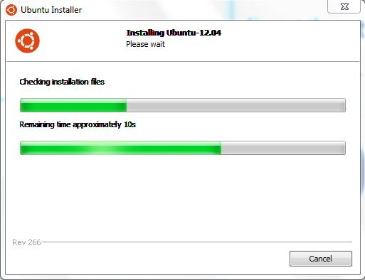
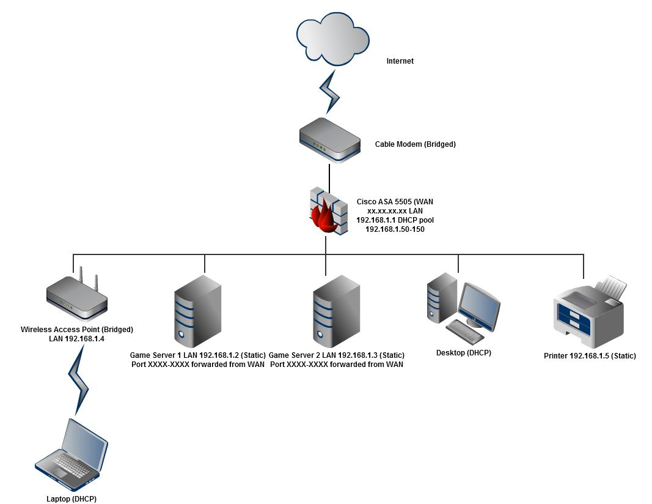
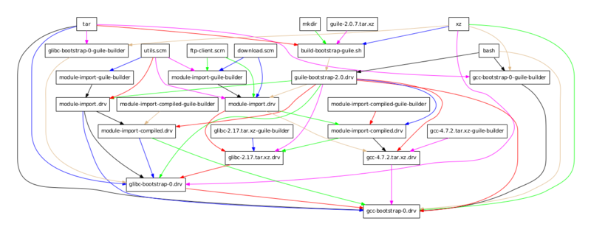
Examples of Customer-Controlled Products
CNT1
CNT2
CNT3
INC1
INC2
INC3
INC4
INC5
Installed on a Machine
Installed in a Network
Library for an Installed Product
This Photo by Unknown Author is licensed under CC BY-SA
This Photo by Unknown Author is licensed under CC BY-SA
This Photo by Unknown Author is licensed under CC BY-SA
Notes:
Examples of customer-controlled products include any software installed on a machine, any thing added to the user’s network, and libraries used to support by either.

Slide 55
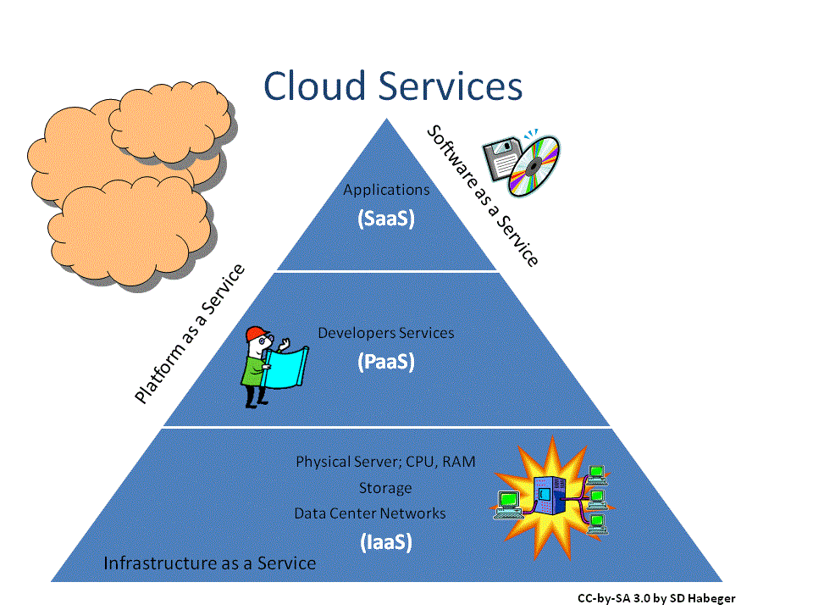
Examples that are Not Customer Controlled
Cloud Services
Individual Website
CNT1
CNT2
CNT3
INC1
INC2
INC3
INC4
INC5
Notes:
It does not include vulnerabilities in cloud services or individual websites. Resolving these vulnerabilities only requires communication between the discoverer and the vendor and does not require a public identifier to coordinate with other third-parties. However, if a cloud service also offers an on-premise version, a CVE ID should be assigned to enable communicate with the users responsible for updating the on-prem installations.

Slide 56
INC4: Publicly Available and Licensable Products
Notes:
INC4 says that the affect product must be generally available and licensable. The intent of this rule is to ensure that the affect product is meant to be used operationally and can be legally obtained. It is meant to exclude vulnerabilities in software for which people aren’t concerned about the security.

Slide 57
Excludes
Betas
Unofficial open source releases
Malware
Internal business software
Code snippets from Stack Overflow
CNT1
CNT2
CNT3
INC1
INC2
INC3
INC4
INC5
Notes:
For example, INC4 is meant to exclude, beta software and unofficial releases which the operator is using at their own risk. Vulnerabilities in malware and internal business software are excluded, as well as, code snippets you find on the internet.

Slide 58
INC5: Check for Duplicates
Notes:
The final inclusion rule (INC5) states that a new CVE ID should not be assigned to a vulnerability if that vulnerability has already been assigned a CVE ID.

Slide 59
Coordinate
Vendor CNA
CNT1
CNT2
CNT3
INC1
INC2
INC3
INC4
INC5
Found XYZ vulnerability
Upstream Vendor
(Not a CNA)
Researcher CNA
Found XYZ vulnerability
Notes:
If a CNA other than the upstream vendor assigns a CVE ID to the vulnerability, then the CNA must make a good faith effort to contact the upstream vendor. Not only is this a good practice that helps the community, but it also helps prevent duplicate assignments. If the CNAs report to the upstream vendor, then the vendor will be able to tell the CNAs whether a CVE ID has been assigned to the vulnerability regardless of whether vulnerability is public.

Slide 60
Typos are the Enemy
CNT1
CNT2
CNT3
INC1
INC2
INC3
INC4
INC5
CVE-YYYY-1234
CVE-YYYY-1324
Notes:
A common cause of duplicates are typos in vulnerability advisories. For example, CVE-YYYY-1234 may have been assigned to the vulnerability but when the advisory was created the middle two numbers are transposed, resulting CVE-YYYY-1324. CNAs are encouraged to double check the IDs in their advisories to ensure they are correct.

Slide 61
Check the CVE List
CNT1
CNT2
CNT3
INC1
INC2
INC3
INC4
INC5
Notes:
Finally, CNAs are expected to check both their internal records and the public CVE List for the vulnerability and only assign a new CVE ID if the vulnerability was not found.

Slide 62
Conclusion
CNT1 – Independently Fixable
CNT2 – Are the bugs vulnerabilities
CNT3 – Determine the affected set of products
INC1 – Determine if they are in your scope
INC2- Determine if you plan on making the vulnerability public
INC3 – Is the affected product customer controlled
INC4 – Is the affected product publicly available and licensable
INC5 – Check for existing assignment
CNT1
CNT2
CNT3
INC1
INC2
INC3
INC4
INC5
Notes:
To conclude, to assign a CVE ID, you first break the report into independently-fixable groups of bugs. You then determine if those groups are vulnerabilities and which set of products they affect. You then determine if those products are in your scope. If they are, determine if you are going to make the vulnerability public and if the product is customer-controlled and publicly available. Finally, make sure that there isn’t a CVE ID already assigned to the vulnerability.

